Slide 1
WebWizard
Web Developmemnt
Bano Qabil 4.0 Summer Session
Prepared By: Waqar Rana
Software Engineer & Instructor

Slide 2
What is Web Development?
Web development means creating things that work on the internet. These are things we can open in a browser (Chrome, Firefox, Edge), such as:
✅ Websites (Google, YouTube, Facebook)
✅ Online Games
✅ Social Media Accounts
✅ Web Apps (Google Docs, Canva)
In simple words, anything that runs on the internet is created through web development! 🎯
Web development is categorized into two main parts:
Frontend Development (Client-Side)
Backend Development (Server-Side)
Both work together to create fully functional websites and web applications.

Slide 3
Frontend Development (Client-Side)
Frontend development focuses on the visual and interactive part of a website—the part users see and interact with in their browser.
Technologies Used in Frontend
To build a frontend, we primarily use three technologies:
HTML (HyperText Markup Language) – Creates the structure of a webpage.
CSS (Cascading Style Sheets) – Styles the webpage (colors, layout, fonts, animations).
JavaScript (JS) – Adds interactivity (buttons, forms, dynamic content).
Frontend Frameworks & Libraries
To speed up development, developers use different
frameworks and libraries:
CSS Frameworks: Bootstrap, Tailwind CSS
JavaScript Libraries: jQuery, React.js
JavaScript Frameworks: Angular.js, Vue.js
Frontend Responsibilities
Frontend developers ensure:
✔ The website is responsive (works on all screen sizes).
✔ The UI/UX (User Interface & Experience) is smooth.
✔ Fast page loading & optimized performance.

Slide 4
Backend Development (Server-Side)
Backend development is responsible for handling the logic, database, and server-side operations of a website. It ensures that the website functions properly by processing data and requests.
Technologies Used in Frontend
Backend development involves programming languages, databases, and servers.
Backend Languages:
✔ JavaScript (Node.js)
✔ Python (Django, Flask)
✔ PHP (Laravel)
✔ Ruby (Ruby on Rails)
✔ Java (Spring Boot)
Databases:
✔ SQL Databases (MySQL, PostgreSQL)
✔ NoSQL Databases (MongoDB, Firebase)
Servers & APIs:
✔ Express.js (Node.js framework)
✔ RESTful APIs & GraphQL
✔ Authentication & Security (JWT, OAuth)
Backend Responsibilities
Backend developers manage:
✔ Data storage & retrieval (using databases).
✔ User authentication (login, signup, security).
✔ Server communication (handling user requests).
✔ Processing logic (business logic of the application)..

Slide 5
Feature | Frontend Developer 🎨 | Backend Developer 🖥️ | Full Stack Developer 🔥
Definition | Works on the visual & interactive part of a website | Manages the server-side logic, databases, and APIs | Handles both frontend & backend development
Focus Area | UI/UX, design, responsiveness, interactivity | Data handling, authentication, server logic | Both UI/UX and backend functionality
Technologies | HTML, CSS, JavaScript, React, Vue, Angular | Node.js, Express.js, Django, Flask, SQL, MongoDB | Uses a combination of frontend and backend technologies
Languages | JavaScript, TypeScript, HTML, CSS | JavaScript (Node.js), Python, PHP, Java, Ruby | JavaScript, Python, PHP, etc. (both frontend & backend languages)
Frameworks | Bootstrap, Tailwind CSS, React, Vue, Angular | Express.js, Django, Flask, Laravel, Spring Boot | Uses both frontend and backend frameworks
Data Handling | No database handling | Works with databases (SQL, MongoDB, Firebase, etc.) | Manages both frontend UI and backend data processing
Main Responsibilities | Building layouts, styling, animations, and interactivity | Managing data storage, authentication, and business logic | Building and maintaining both client-side & server-side
Example Task | Creating a navigation bar, buttons, animations | Creating an API that fetches data from a database | Developing a complete website with both UI & data handling
Tools | VS Code, Chrome DevTools, Figma | Postman, MySQL Workbench, API testing tools | Uses both frontend & backend tools
Salary (on average) 💰 | $60K - $90K per year | $70K - $110K per year | $80K - $130K per year
Career Path | Frontend Engineer, UI/UX Designer, Web Developer | Backend Developer, Software Engineer, DevOps Engineer | Full Stack Developer, Software Architect, Tech Lead
Best For | Those who enjoy design, UI/UX, animations, and responsiveness | Those who prefer logic, data processing, APIs, and databases | Those who want to handle everything from frontend to backend

Slide 6
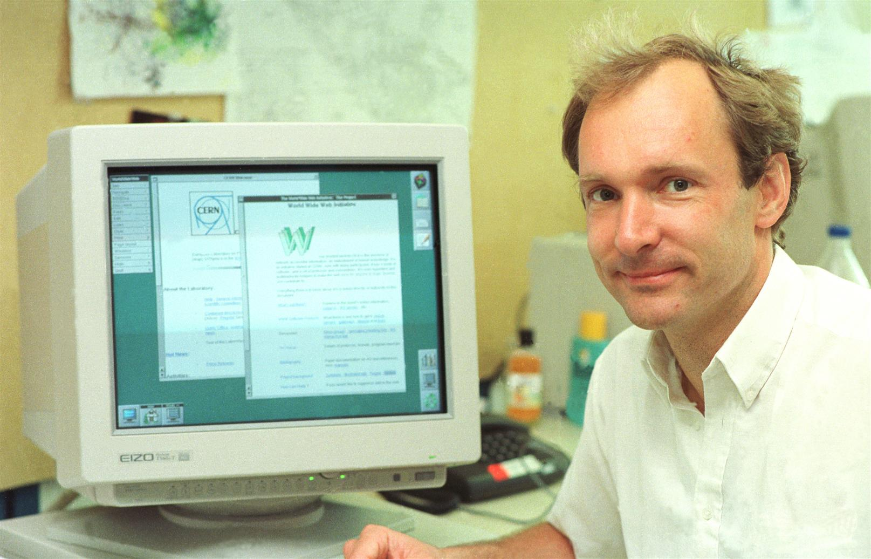
What is HTML?
HTML (HyperText Markup Language) is a markup language used to create websites and web applications. It defines the structure of a webpage, including headings, paragraphs, images, links, buttons, and forms.
If you want to build a website, you cannot do it without HTML. It is a fundamental technology that works alongside CSS and JavaScript to create a complete webpage design.
Why Was HTML Created?
The purpose of HTML was to provide a universal language that could work in any browser worldwide and display webpages in a standardized way.
Earlier, different organizations and software had their own
methods for creating websites, leading to compatibility issues.
To solve this problem, Tim Berners-Lee introduced the concept
of HTML.
Tim Berners-Lee

Slide 7
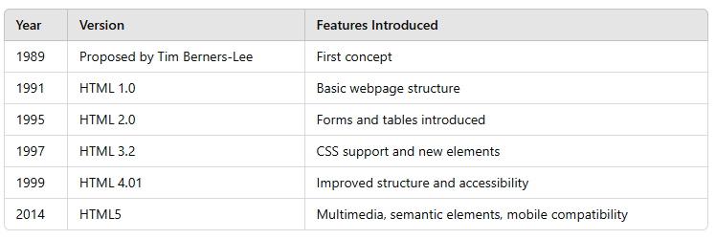
History of HTML
HTML has evolved over the years, introducing new features and updating older standards.
Today, HTML5 is the standard, supporting new features like audio, video, canvas, local storage, geolocation, responsive design, and SEO-friendly tags.

Slide 8
Who Created HTML?
HTML was created by Tim Berners-Lee, a British scientist. He proposed the idea in 1989 and published the first HTML documentation in 1991.
At that time, he was working at CERN (a European research organization). His goal was to develop a system that allowed researchers to easily share knowledge.
Where Was HTML Used for the First Time?
The first webpage created using HTML was developed by Tim Berners-Lee for CERN. It was a simple text-based page with hyperlinks.
You can still view this page online:
🔗 First Website

Slide 9
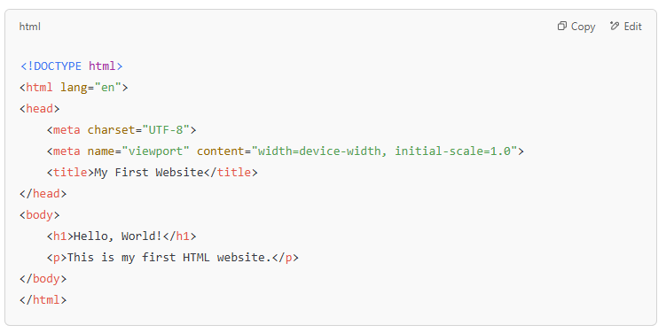
What is HTML Syntax?
HTML syntax starts with a document type declaration, followed by <html>, <head>, and <body> elements.

Slide 10
Why Are HTML Elements Called "Tags"?
A tag is a special keyword enclosed in angle brackets (< >) that represents an element.
<p>This is a paragraph.</p>
✅ <p> → Opening tag
✅ This is a paragraph. → Content
✅ </p> → Closing tag
🔹 Why is it called a "Tag"?
✔ It is part of a marking system that tells the browser how to display content.

Slide 11
What is HyperText?
HyperText refers to interactive text that links to another document or webpage.
<a href="https://www.google.com">Google</a>
✅ Here, "Google" is hypertext linked to a URL. Clicking on it will take you to Google.
✔ Connects different links
✔ Provides navigation
✔ Makes web browsing easier
What is a Markup Language?
A markup language defines the structure of text and content.
✔ HTML is a markup language because it uses tags to structure content.
✔ It is not a programming language because it does not include logical operations (like loops or conditions).
✔ Markup languages only define presentation and formatting.

Slide 12
To create the structure of any website using HTML, we need three things:
A text editor
A browser
Knowledge of HTML
Book: https://wtf.tw/ref/duckett.pdf

